Slide 1

Bridge Akashi Kaikyo
By Doreen

Slide 2
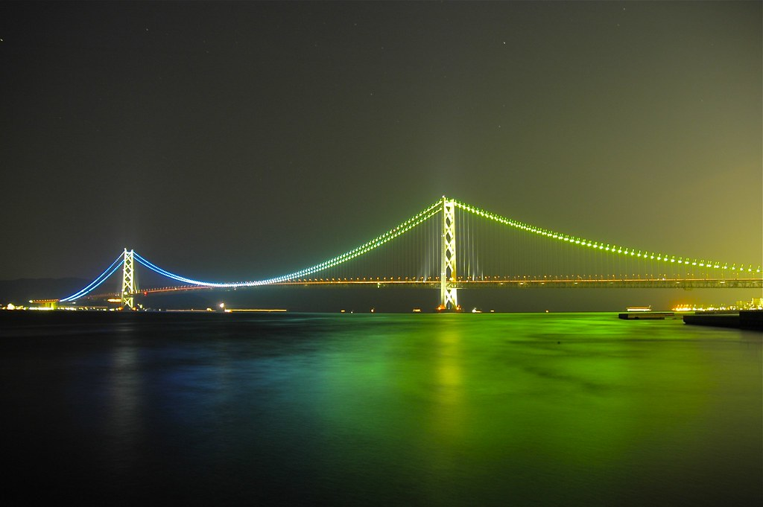
Measurements
The Akashi Kaikyo Bridge is the length of 12,831 feet.
  It was built in 1988 – 1998 and it took 10 years to complete.
2 million workers worked for 10 years to construct.

Slide 3
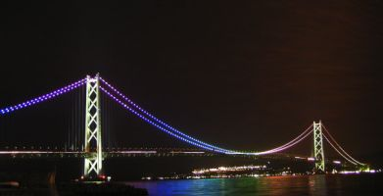
Interesting Facts
    Two million workers worked for 10 years to construct the Akashi Kaikyo bridge.
The Akashi is in a typhoon region where winds can reach up to speeds of 290 kmph.
The total cost of the Akashi Kaikyo Bridge was 4.3 billion dollars.
This bridge is in Japan

Slide 4
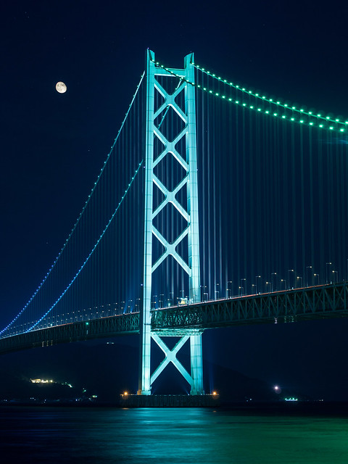
Comparison
The Akashi Kaikyo bridge is 13,541 feet less than the Mackinac bridge in Michigan.

Slide 5
Researched and produced by
Doreen
2^{nd grade}
Buck Lake Elementary
Tallahassee, FL
2019

